Slide 1

Proximity/distance Measures- part 3
Dr. Umarani Jayaraman
Assistant Professor

Slide 2
Topic:
Mahalanobis distance

Slide 3

Quadratic form distance
For example A_{ij}=1-c_{ij}/c_{max} for color histograms
c_{ij} is bin-to-bin distance and c_{max} the maximum distance
Note
If A is an identity matrix, then Euclidean
If A is a diagonal matric, then weighted Euclidean
If A is a inverse of covariance matrix, then Mahalanobis distance
Is it a Metric? Yes , if A is positive definite

Slide 4
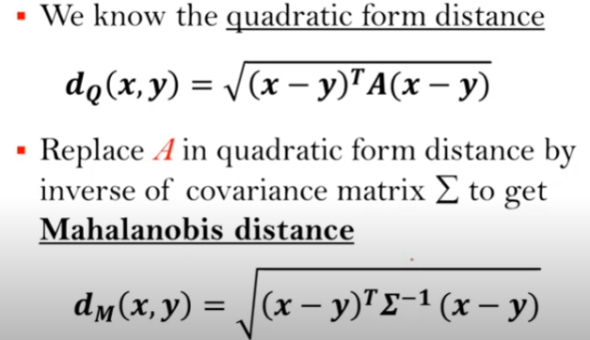
Mahalanobis distance

Slide 5
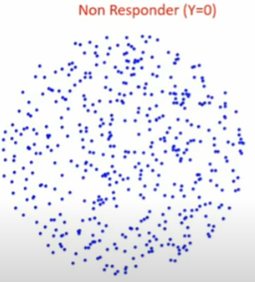
Issue of Euclidean distance
Classification Problem

Slide 6
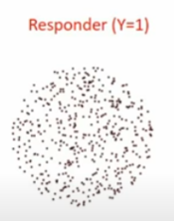
Issue of Euclidean distance
Classification Problem

Slide 7

Issue of Euclidean distance
Classification Problem

Slide 8
Issue of Euclidean distance
Calculate distance of the new object from mean of different populations
Assign it to the group, from which it is closest

Slide 9
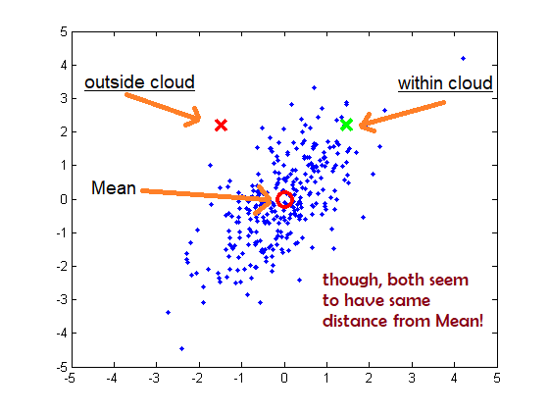
Issue of Euclidean distance
It fails to capture the points which is outside the distribution as outliers

Slide 10
Intuition of MD: Finding Outliers

Slide 11
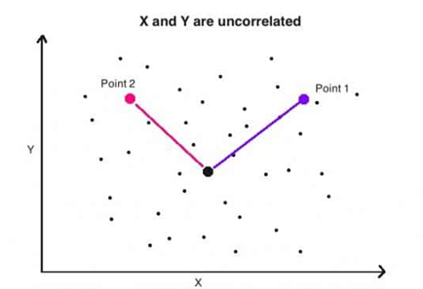
Intuition of MD
When X an Y are uncorrelated, the Euclidean distance from the centroid can be useful to infer if a point is member of the distribution
If the distance is lesser, then it is more likely a member of the distribution

Slide 12
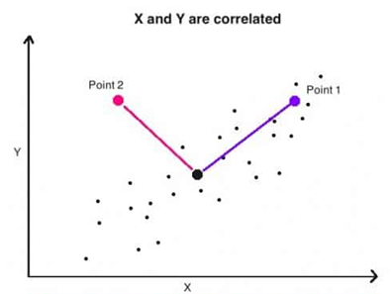
Intuition of MD
Both point 1 and point 2 have the same Euclidean distance from centroid.
But only point 1 is a member of the distribution
To detect point 2 as outlier, dist (point 2, centroid) should be much higher than dist (point 1,centoid)
Mahalanobis distance can be used here instead.

Slide 13
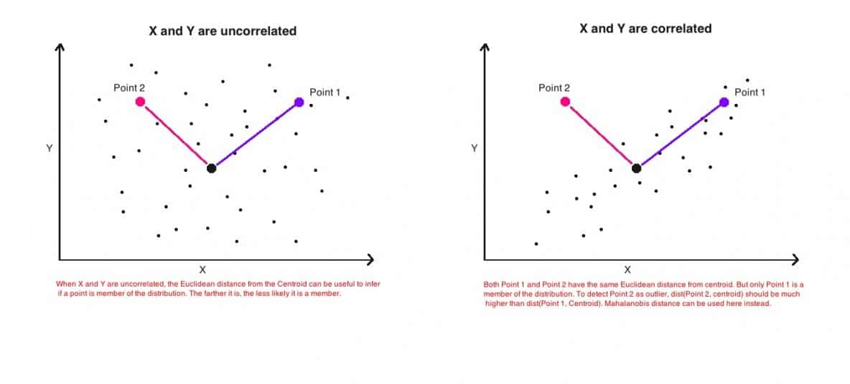
Intuition of MD

Slide 14
Mahalanobis distance
Mahalanobis distance does the following
It transforms the variables into uncorrelated variables
It makes their variance equal to 1 (unit variance)
Then it calculates the simple Euclidean distance

Slide 15

Mahalanobis distance
Normalized Euclidean
x_{i}’= x_{i}-μ_{i} / σ_{i} (i is the i^{th} component of the feature vector)
Mahalanobis distance
It actually does the normalization in multi variate before computing the Euclidean distance
If the covariance is higher then we divide it by high value (covariance matrix)
If the covariance is lesser then we divide it by low value (covariance matrix)
Distance from mean
Divide by covariance matrix

Slide 16
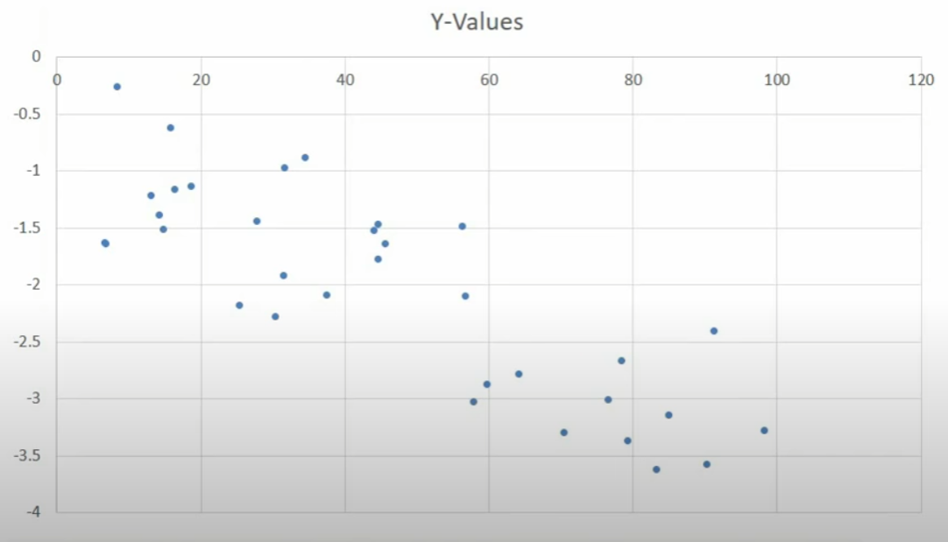
Graphic representation

Slide 17
Graphic representation

Slide 18
Graphic representation

Slide 19
Graphic representation

Slide 20
Graphic representation

Slide 21
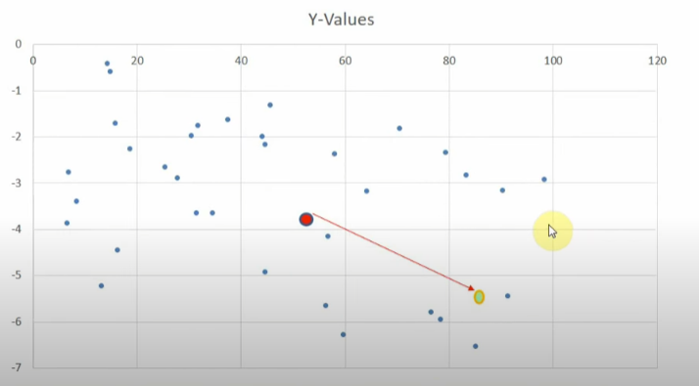
Graphic representation
When data is uncorrelated

Slide 22
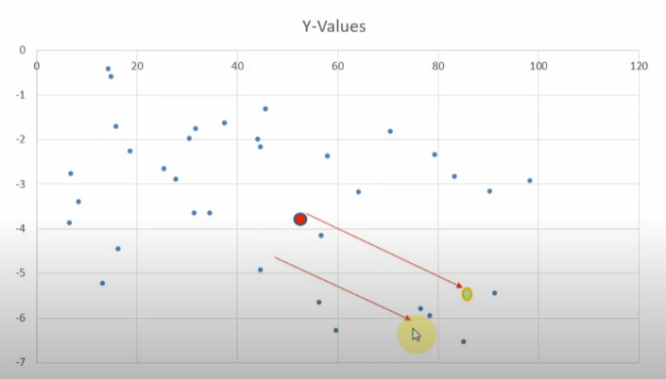
Graphic representation
When data is uncorrelated

Slide 23
Summary
Metric distance measure
Mahalanobis distance
Institution behind MD

Slide 24
Thank you

